Slide 1
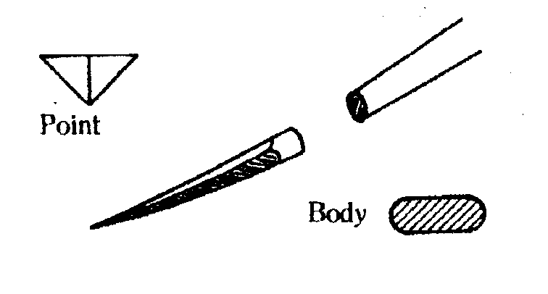
SUTURE PATTERNS AND SUTURE TECHNIQUES
Interrupted suture
Tied separately-several stitches
Slow
Secure
Good apposition
No strangulation of margins
Implant more sutures

Slide 2
Continuous suture
Tie at beginning and end
Single suture
Fast
Strangulation of wound margins
Insecure
Less suture material implanted

Slide 3
Simple suture patterns
Single needle insertion
Not good for tension, cut thru, good appose
Mattress suture patterns
Two needle insertions
Good for tension, causes evertion/inversion
Tension sutures-reduce tension 1º line
Mattress sutures, away from margins

Slide 4
Pull-out suture
To be removed
4 group of suture patterns
Apposing (appositional)-anatomical healing
Inverting—compromise lumen size
Everting –compromise lumen size
special

Slide 5
Suture placement techniques
0.5 cm both ways
Too close
Too separated
Too tight
Best coaptation
Best suture pattern and technique

Slide 6
Basic suture patterns
Apposing patterns
Simple interrupted
Single needle insertion each side

Slide 7
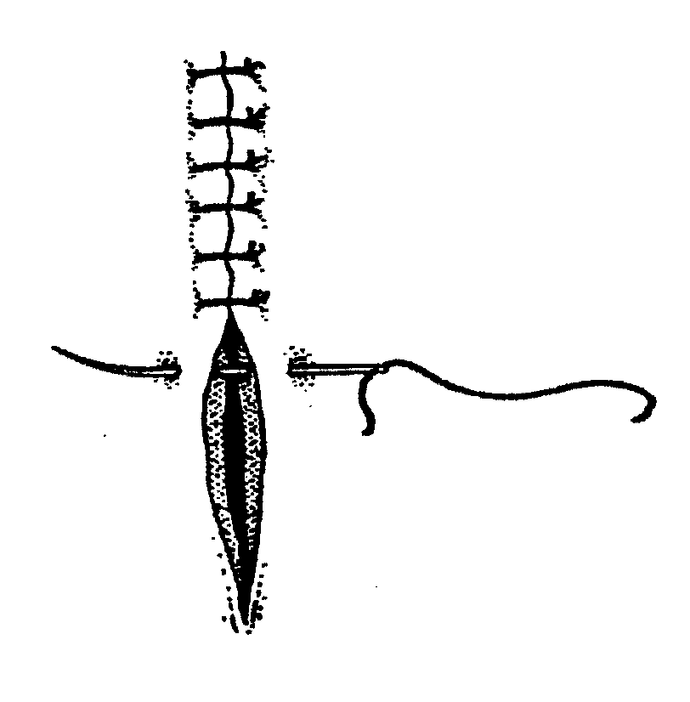
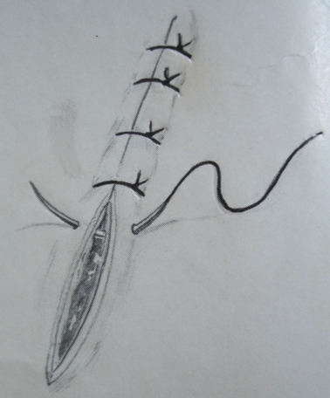
Simple interrupted

Slide 8
2.Simple continuous
One passage, tied, continued to the end

Slide 9
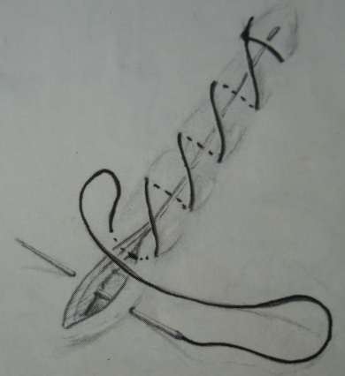
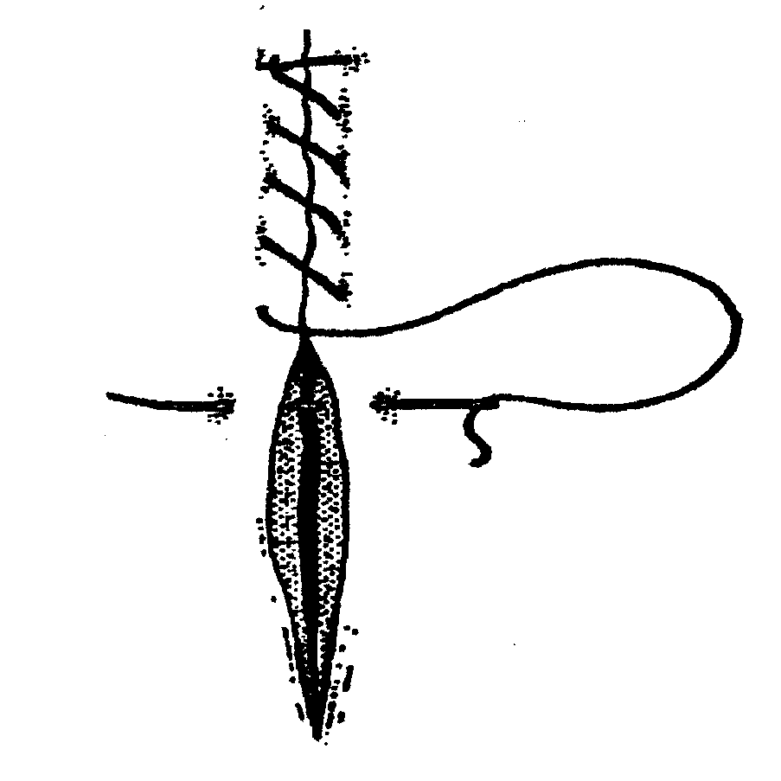
2.Simple continuous

Slide 10
3. Cruciate (cross) mattress
Single passage
Back to starting side
Another passage
Knot
Forms “X”
Repeat
No compromise of blood supply

Slide 11
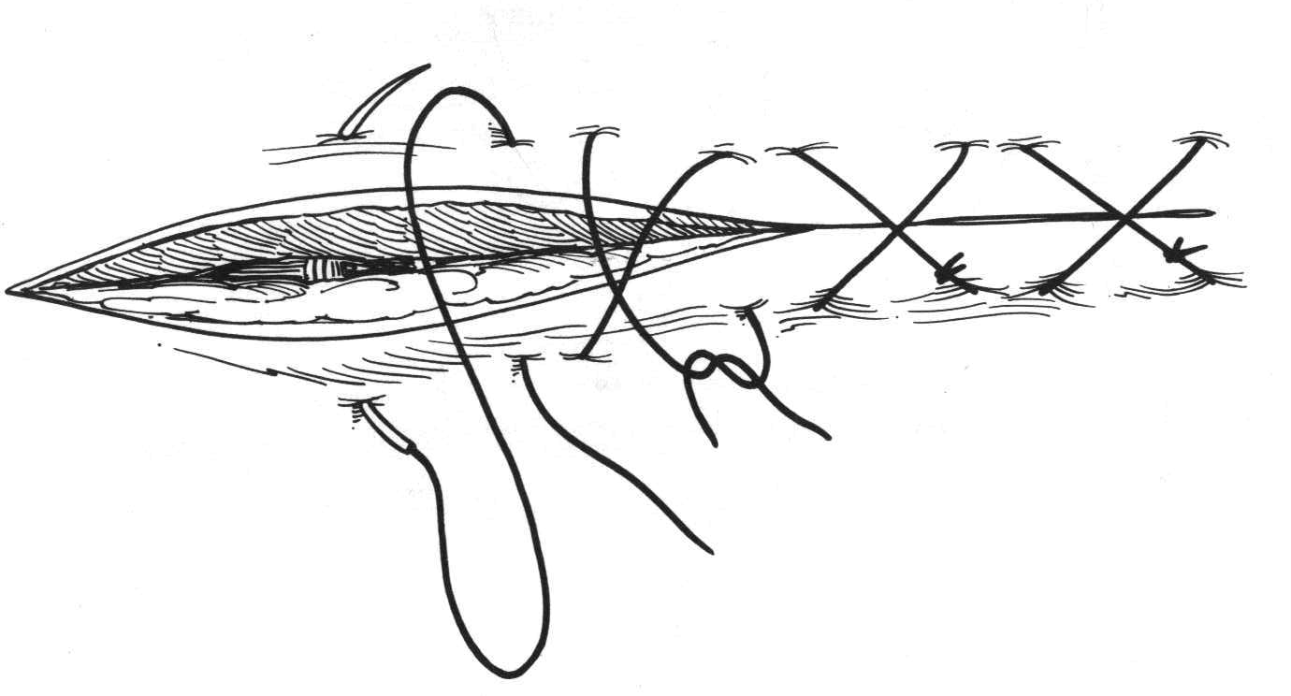
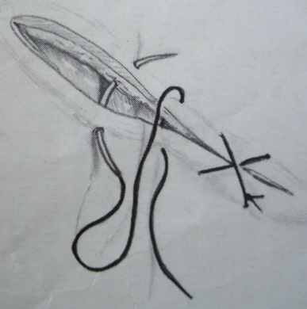
Cruciate (cross) mattress

Slide 12
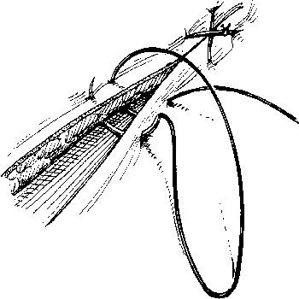
Cruciate

Slide 13
4. Figure eight mattress
Forward diagonal bite
Backward diagonal bite
Knot, repeat, “X” underneath

Slide 14
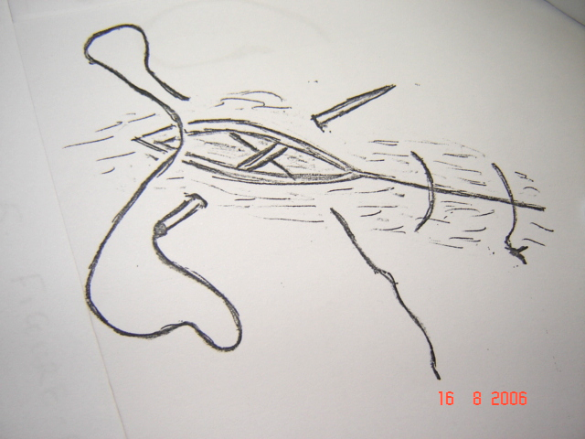
4. Figure eight mattress

Slide 15
5. Interlocking suture
(ford interlock, lock stitch, blanket, Reverdin’s)
Modification of simple continuous
Perpendicular passage, needle drawn into preformed loop to lock.
End in opposite direction
Good skin closure

Slide 16
Interlocking suture
--

Slide 17
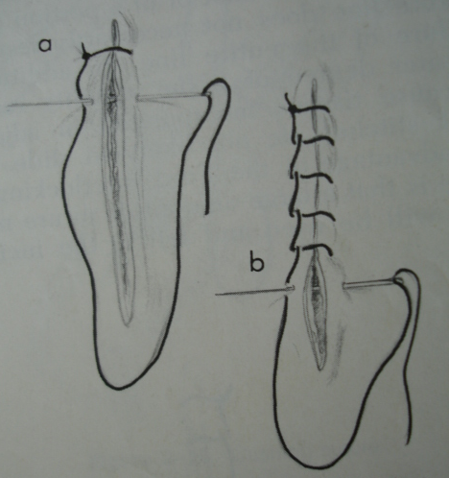
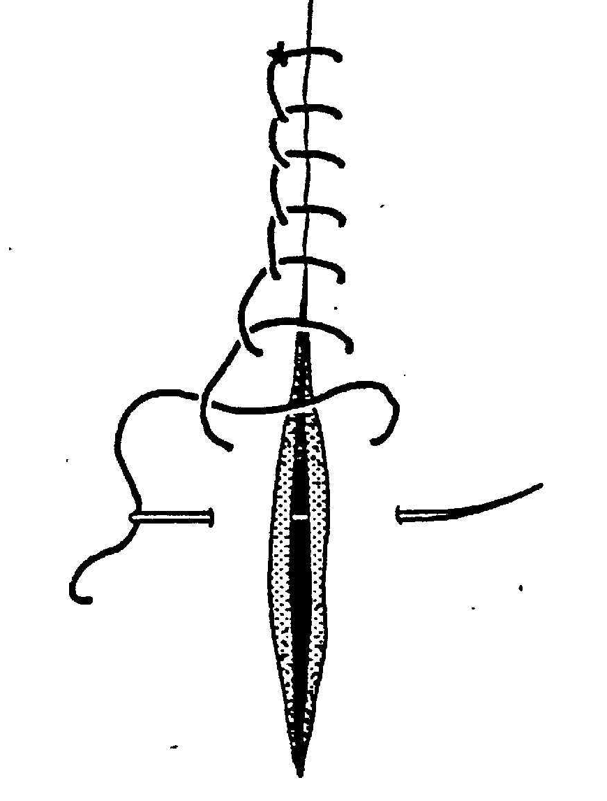
Interlocking suture

Slide 18
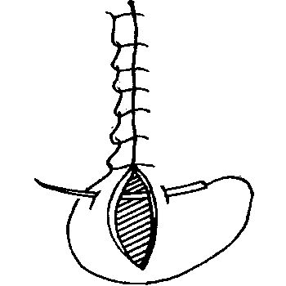
Lock-stitch

Slide 19
INVERTING PATTERNS
Lembert suture (far-near-near-far)
Combines tension and apposition
When mild tension required to appose
Inversion dependent on tightness
Insertion far on one margin and emerge near same margin.
Near on 2nd margin and emerge far on same margin

Slide 20
Lembert suture
Interrupted or continuous

Slide 21
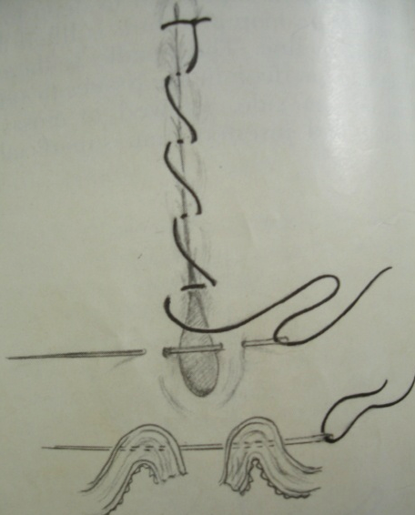
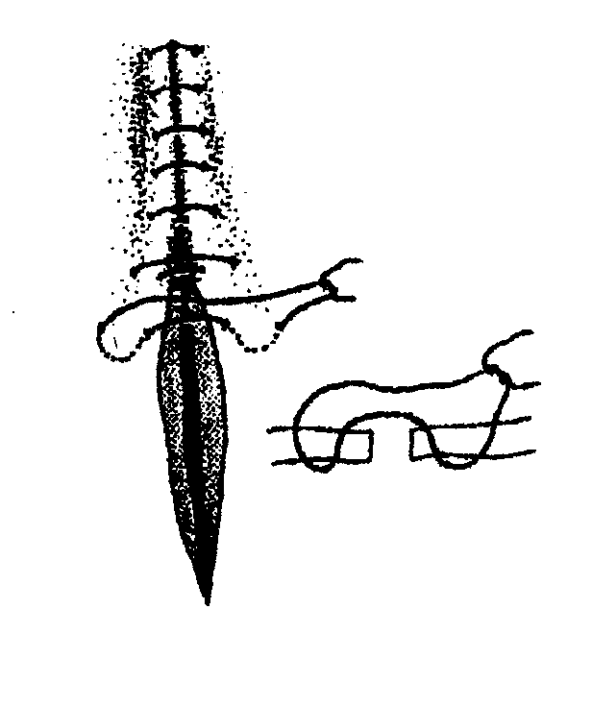
Lembert suture

Slide 22
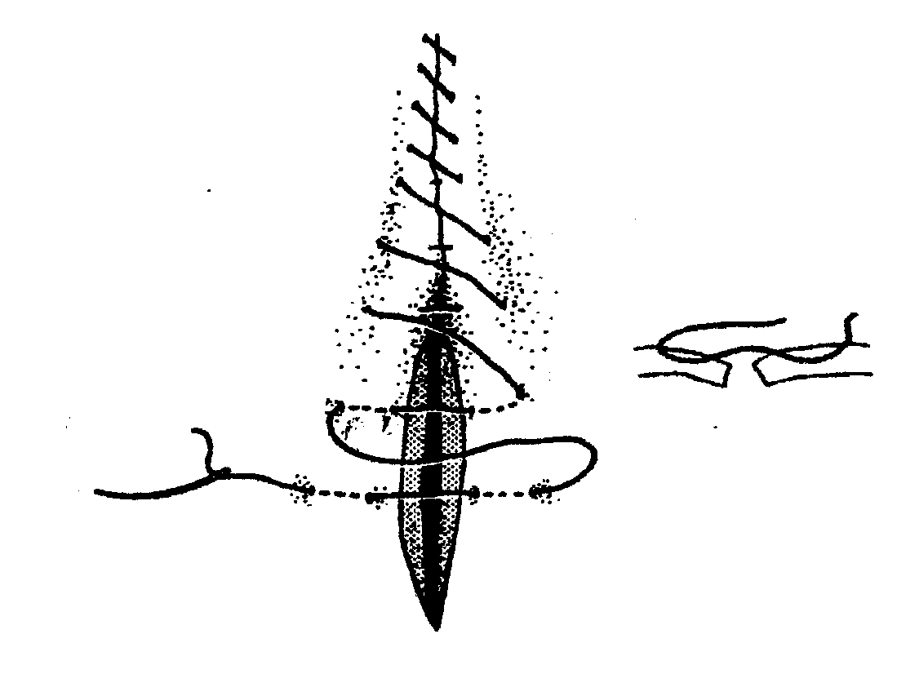
Lembert suture

Slide 23
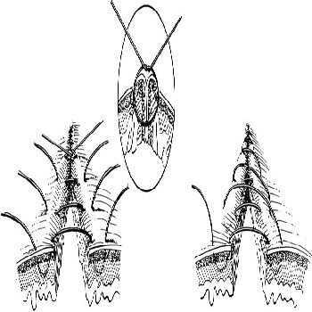
Lembert

Slide 24
3. Halstead (interrupted quilt)
Double lembert
interrupted

Slide 25
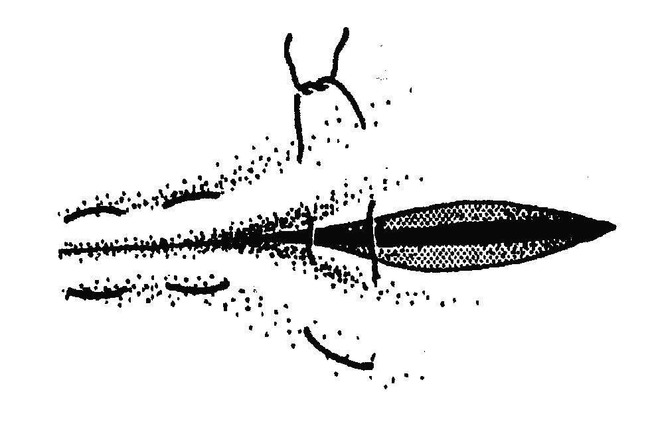
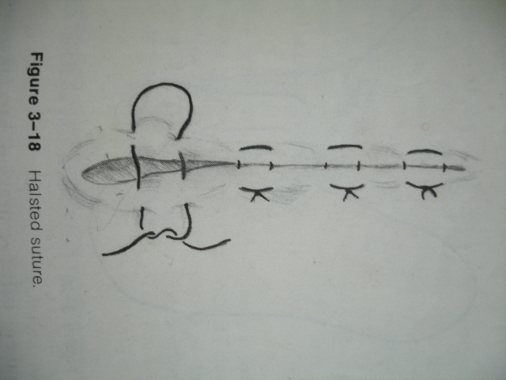
Halstead

Slide 26
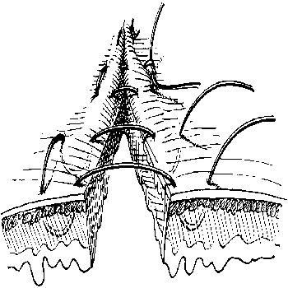
Halstead

Slide 27
4. Cushing and Connell
Cushing- Seromuscular
Connell-deep
Inverting mattress
Cushing good for oversewing
Bites parallel to the wound margins
Crosses over perpendicularly
Continuous

Slide 28
Cushing and connell
--

Slide 29
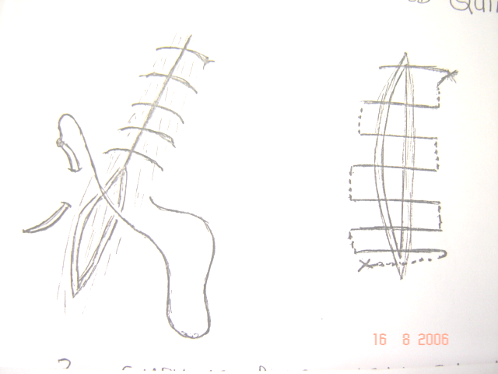
Cushing and connell

Slide 30
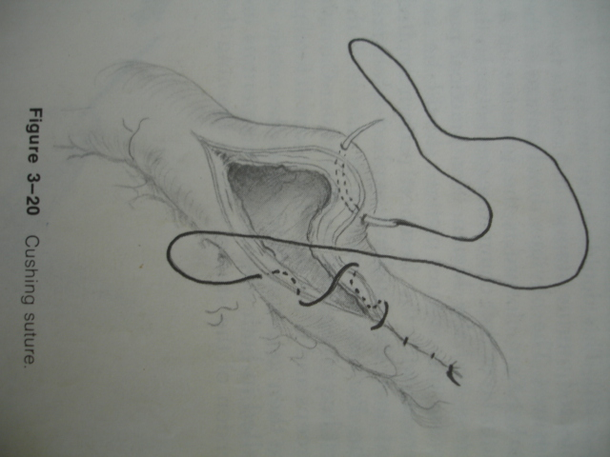
Cushing

Slide 31
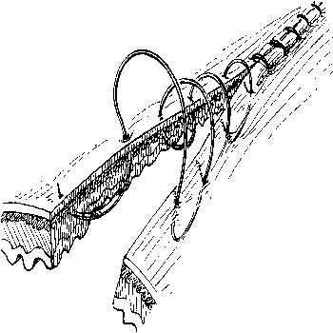
Connell

Slide 32
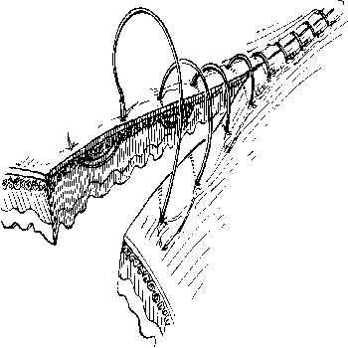
Cushing

Slide 33
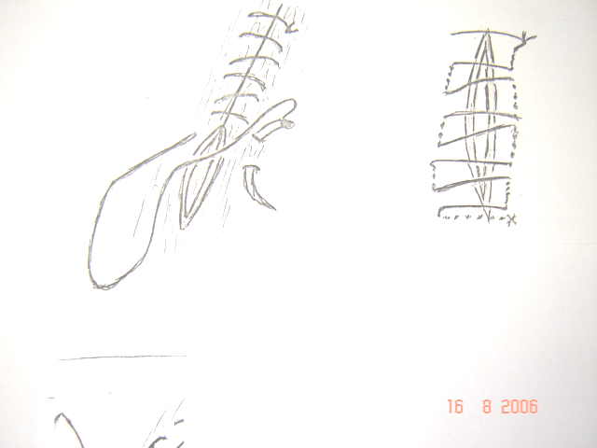
5.Modified cushing

Slide 34
6. Schmeiden suture
Hysterotomy incision
Bites inside-out
Continuous
Suture interposed
Oversewn with cushing

Slide 35
Schmeiden suture
--

Slide 36
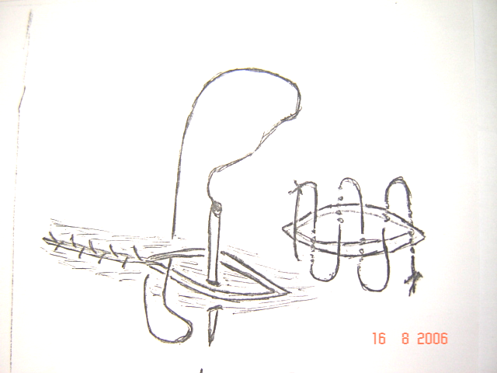
Schmeiden suture

Slide 37
7. Far-near-near-far suture
Areas of mild tension
Interrupted
Far on 1st margin emerge near on 2nd margin
Near on 1st margin emerge near on 2nd margin

Slide 38
Far-near-near-far suture
-

Slide 39
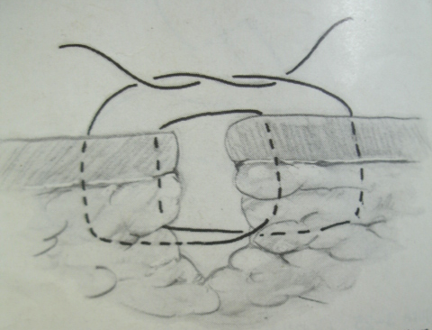
Far-near-near-far suture
-

Slide 40
8. Far-far-near-near suture
Areas of mild tension
Interrupted
Bite far on 1st margin emerge far on 2nd margin
Bite near on 1st margin emerge near 2nd margin

Slide 41
Far-far-near-near suture
-

Slide 42
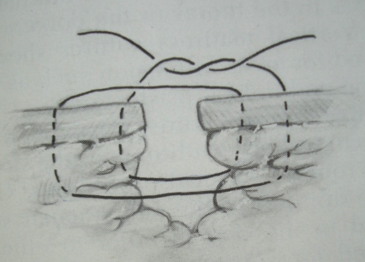
Far-far-near-near suture
-

Slide 43
EVERTING PATTERNS
1.Horizontal mattress
Bites perpendicular
Bites far from margins
Large skin wounds
Areas of tension
Basic tension suture (modified)
Compromise blood supply, interrupted or continuous

Slide 44
Horizontal mattress
-

Slide 45
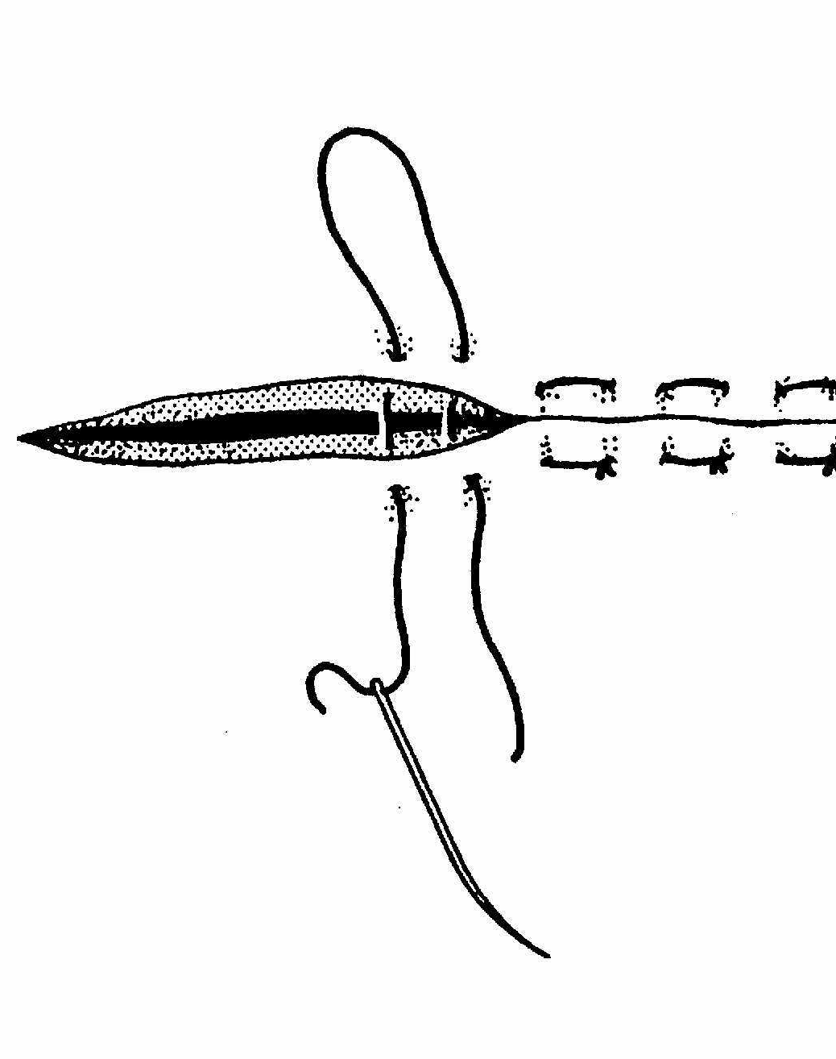
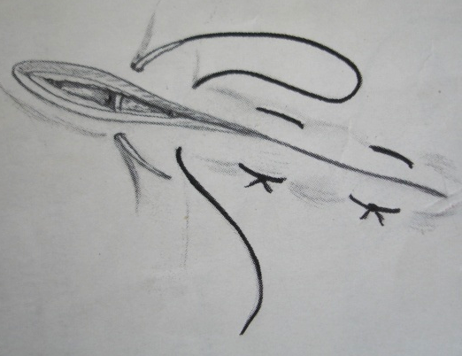
Horizontal mattress

Slide 46
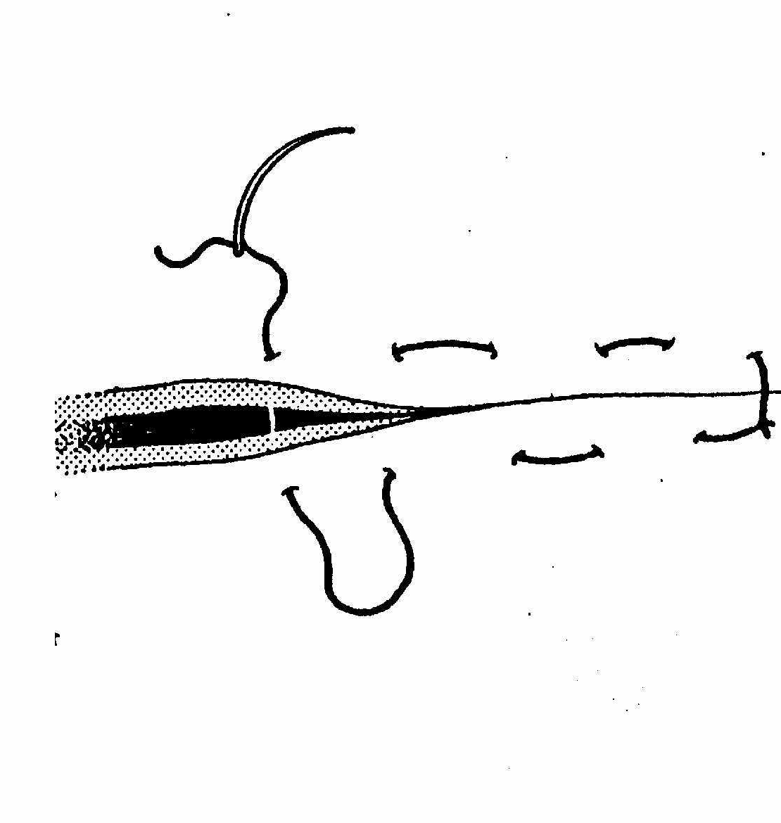
Horizontal mattress

Slide 47
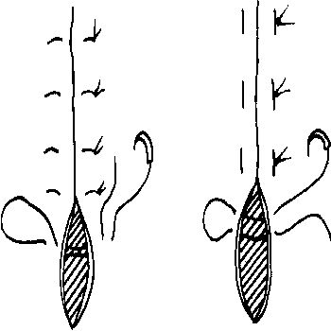
Horizontal mattress

Slide 48
2. Vertical mattress (far-far-near-near)
1st bite far from one margin emerging far on 2nd margin
2nd bite near 2nd margin out near 1st
1st bite deep and 2nd superficial in the same plane
Interrupted
Basic tension suture
No blood supply compromise

Slide 49
Vertical mattress
-

Slide 50
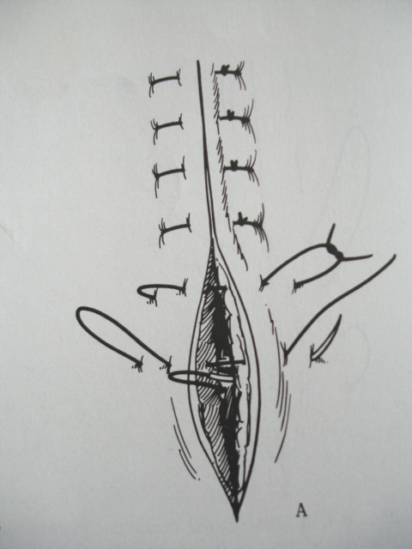
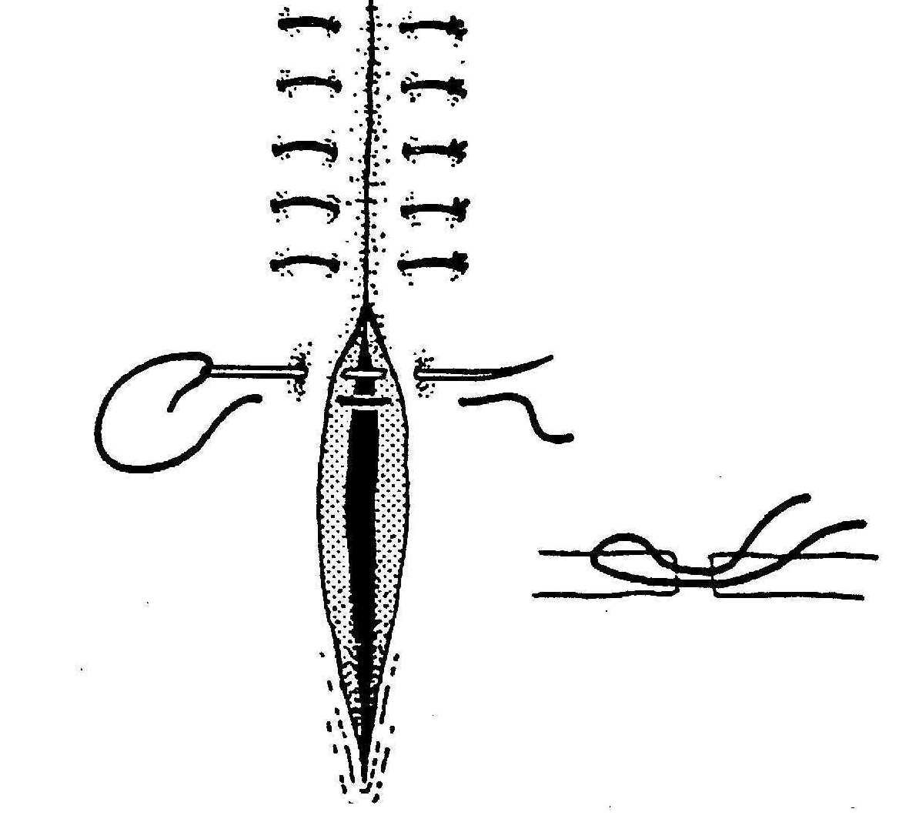
Vertical mattress

Slide 51
Vertical mattress

Slide 52
SPECIAL PATTERNS
Imbricating suture (overlapping mattress, Mayo-mattress,vest-over-pants)
Closure of hernia rings
Pre-placing the sutures
First bite into the ring
Over the opposite ring edge

Slide 53
Imbricating suture cont’d
2nd bite along the ring
Back over the ring edge
3rd bite from inside the 1st ring edge
Hold with forceps
Repeat several sutures
Tighten simultaneously and knot each
Over-sewn with simple continuous or cushing

Slide 54
Imbricating suture cont’d
.

Slide 55
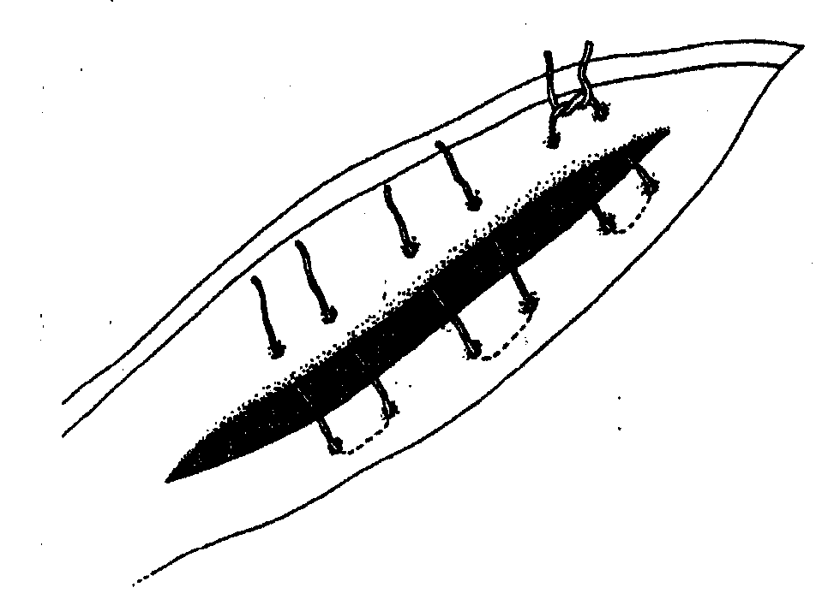
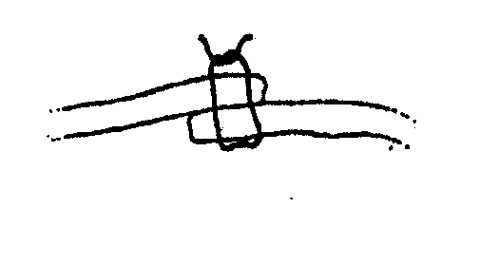
Imbricating suture cont’d

Slide 56
2. Purse-string suture
Continuous
Round opening
Narrow the opening
Anus, preputial

Slide 57
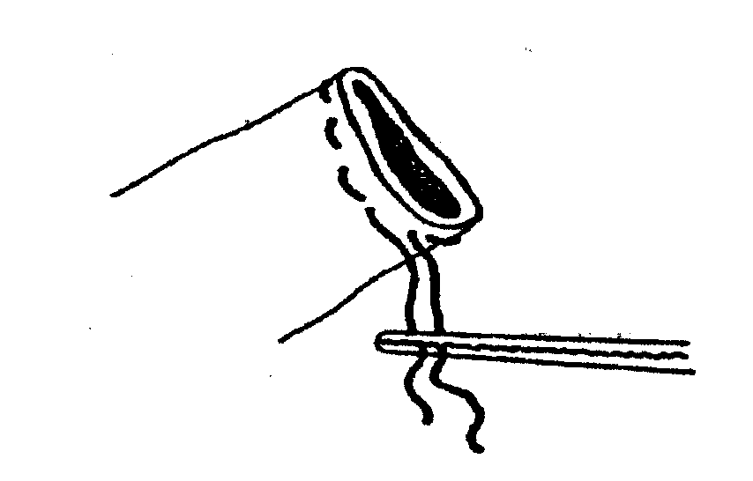
Purse-string suture

Slide 58
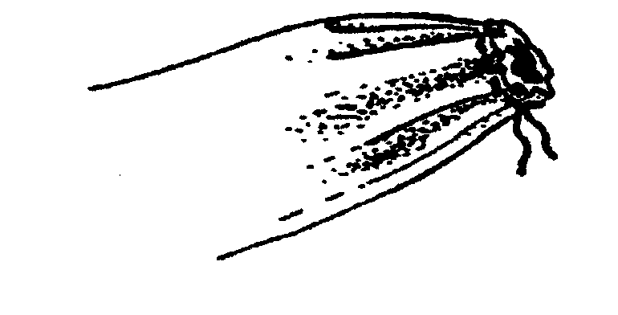
Purse-string suture

Slide 59
3. Parker Kerr
Basic sutures-cushing and Lembert
Hollow viscus
Continuous to completion
Clamping of the stump
Clamp removed as suture is tightened

Slide 60
Parker Kerr
-

Slide 61
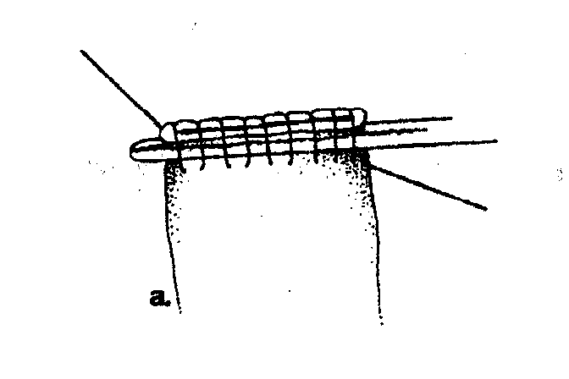
Parker Kerr

Slide 62
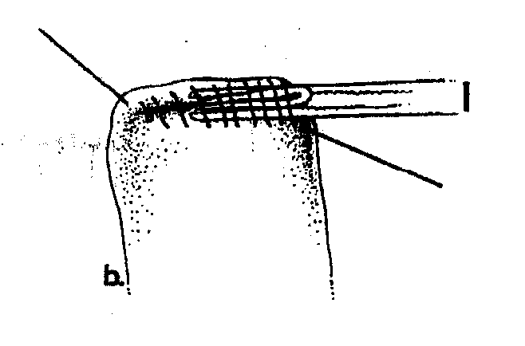
Parker Kerr

Slide 63
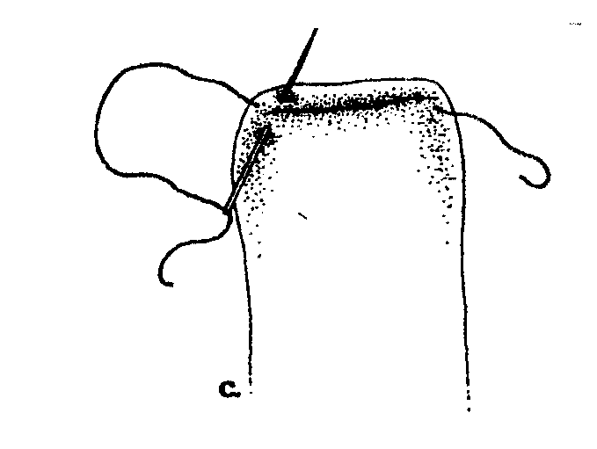
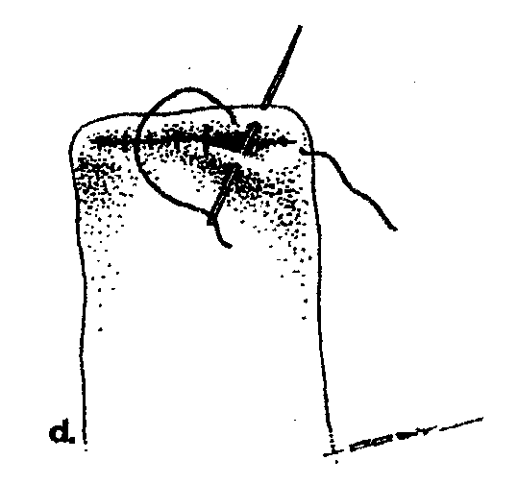
Parker Kerr

Slide 64
4. Subcuticular suture
Obliterate dead space
Subcutaneous bites only
Bites paralles to skin margins

Slide 65
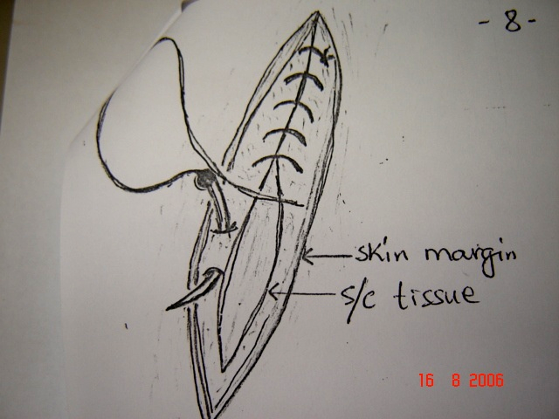
Subcuticular suture cont’d

Slide 66
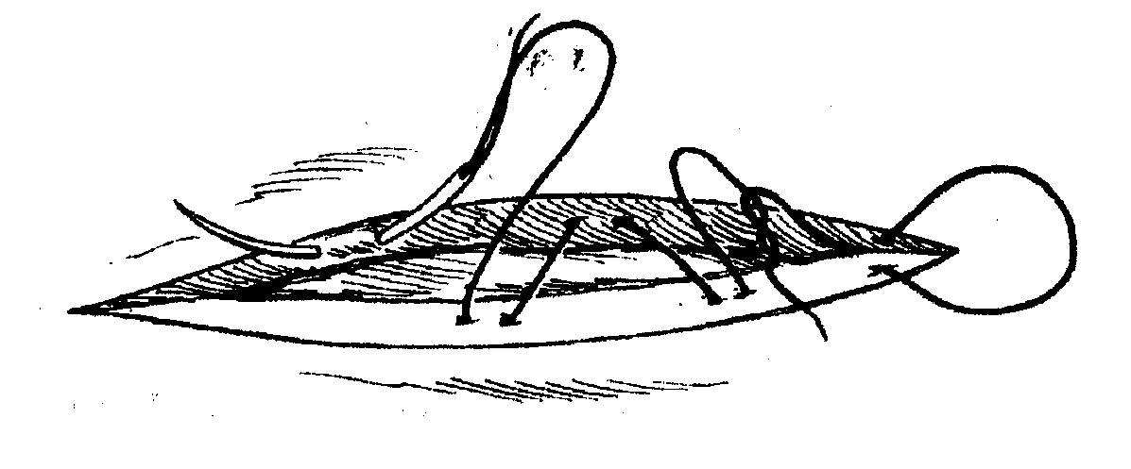
Subcuticular suture cont’d

Slide 67
5. Tension suture
Horizontal and vertical mattress
Button sutures or quilled sutures
Simple interrupted to appose margins
Areas of high tension

Slide 68
Tension sutures cont’d
-

Slide 69
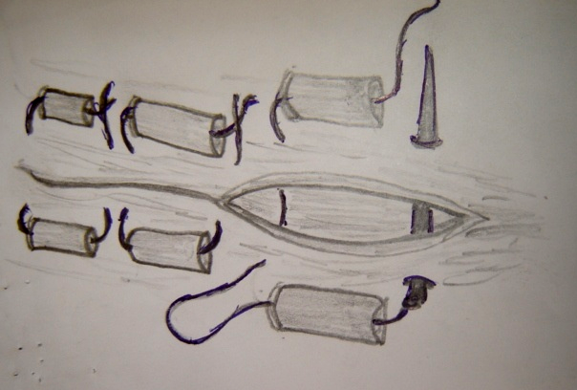
Tension sutures cont’d

Slide 70
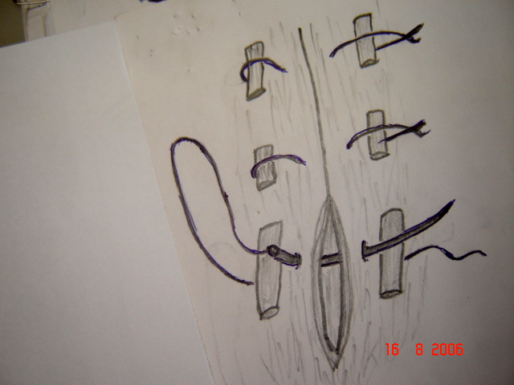
Tension sutures cont’d

Slide 71
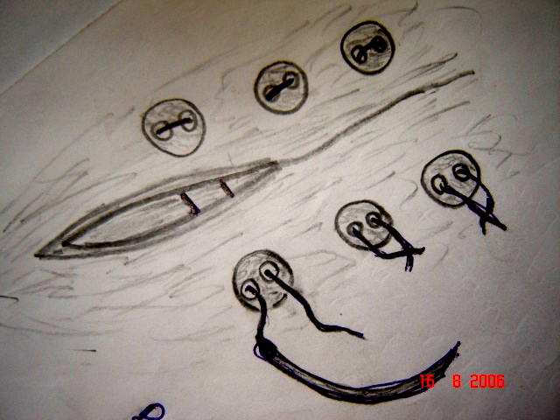
Tension sutures cont’d

Slide 72
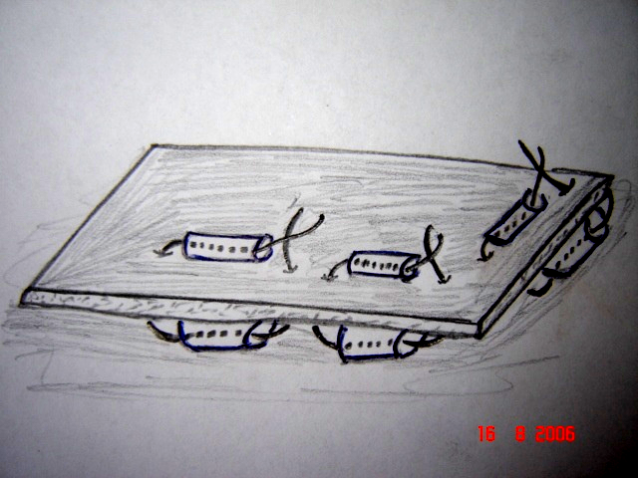
Tension sutures –through- and-through suture

Slide 73
6. Tendon sutures
Severed tendons
Non-absorbable sutures
External coaptation as support to minimize extreme forces
Bunnell tendon suture
Locking-loop tendon suture

Slide 74
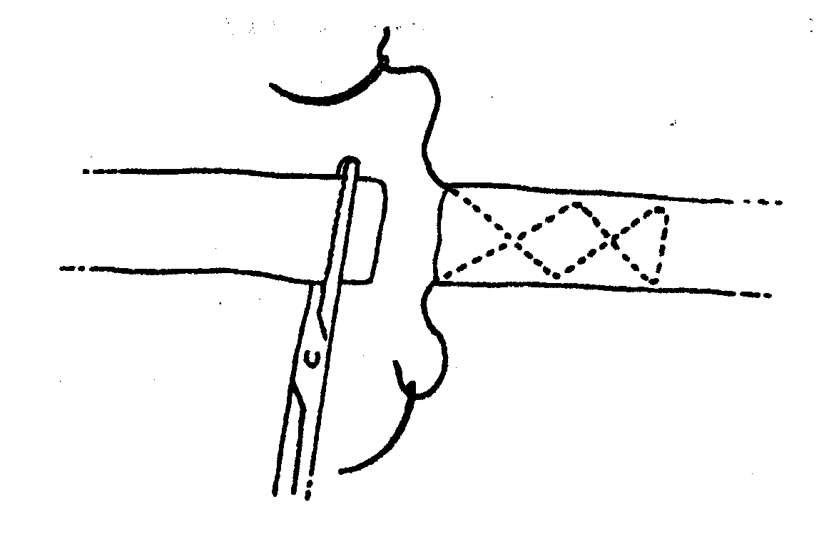
Bunnell (figure eight) tendon suture

Slide 75
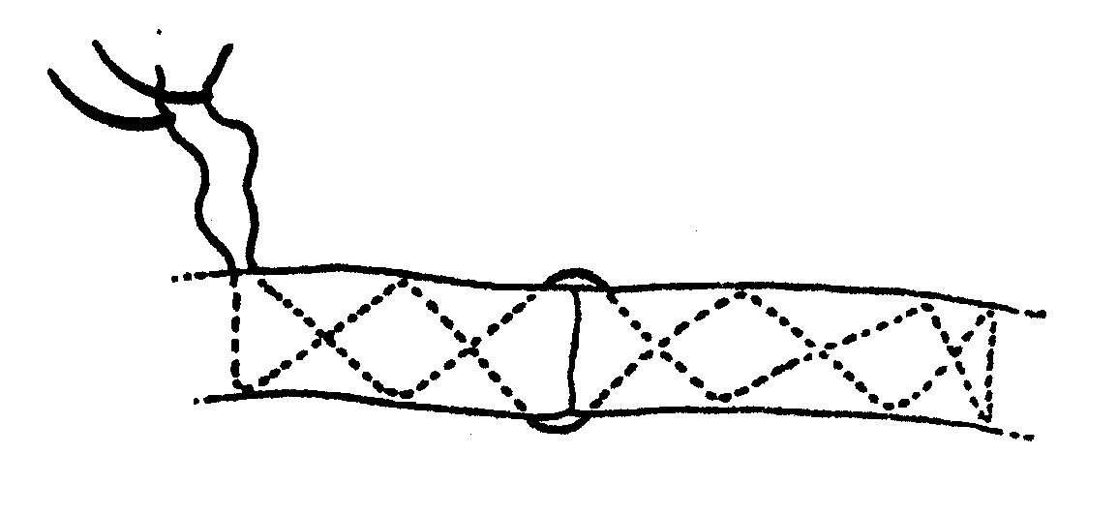
Bunnell (figure eight) tendon suture

Slide 76
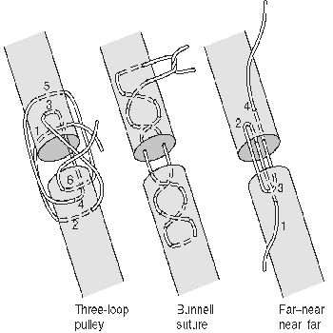
Tendon sutures

Slide 77

Bunnell (figure eight) tendon suture

Slide 78

Locking-loop tendon suture

Slide 79

Locking-loop tendon suture

Slide 80
7. Stent bandage suture
Use of gauze and suture
Covers the wound
Pressure and control of haemorrhage
Simple interrupted

Slide 81

Stent bandage suture

Slide 82

Stent bandage suture

Slide 83

Stent bandage suture

Slide 84
8. LIGATURES
Loop of suture to occlude blood vessel before severing
Simple ligature
Tied round the vessel
Problem for large vessel

Slide 85

Simple ligatures cont’d

Slide 86
Transfixation ligature
Suture passed thru the middle of vessel
Oozing of blood thru needle holes
Simple ligature proximal
Holding vessel with haemostatic forceps

Slide 87

Transfixation ligature contd

Slide 88
9. Gambee suture
Crushing technique
Intestinal anastomosis
Interrupted suture
Needle passage from serosa to lumen
Back to submucosa to lumen of 2nd segment
Back to serosa and knotted

Slide 89

Gambee suture

Slide 90

Gambee suture pattern

Slide 91
Knotting techniques
Speed and efficiency
Single hand-tie
Two hand-tie
Needle holder-tie

Slide 92
Square knot
Small knot
Not frequently used
Fine and friable tissue
All throws looped once

Slide 93

Square knot

Slide 94

Granny knot
Slip knot
Not recommended

Slide 95
Surgeon’s knot
Excessive tension
Thick tissue
1st throw looped twice
Subsequent throws looped once
Bulkier knot
Most commonly used

Slide 96

Surgeon’s knot

Slide 97
Reinforced surgeon’s knot
Extreme tension
1st throw looped more than twice
Sutures with poor knot security
Bulkiness of the knot

Slide 98

Reinforced surgeon’s knot

Slide 99
Knot burying
Suture hidden beneath the tissue surface
Prevent excessive irritation by suture ends
Prevent pressure necrosis on underlying tissue
Needle deep into subcutaneous tissue
Emerge near the skin beneath dermis

Slide 100

Knot burying

Slide 101
Ending continuous suture
Use of loop of the last needle passage
Pulling suture end long before last needle passage

Slide 102

Ending continuous suture

Slide 103

Ending continuous suture

Slide 104
Suture needles
Shapes
Sizes
Non-cutting or round-bodied
Cutting
Conventional cutting
Reverse cutting
Taper cutting
Parts and swaged

Slide 105

Suture needles
⅝
⅜
½
J-shaped
straight

Slide 106

Suture needles
Swaged needle
Swaged-on suture

Slide 107

Suture needles
Regular/conventional cutting

Slide 108

Suture needles
Reverse cutting

Slide 109
Suture needles
Taper-cutting

